Slide 1

TR
ISTANBUL MEDIPOL UNIVERSITY
BUSINESS AND MANAGEMENT SCIENCES
UNDERGRADUATE THESIS
AUTOMATIC GROUND COLLISION AVOIDANCE SYSTEM ALGORITHM DESIGN
HILAL TURKYILMAZ
MANAGEMENT INFORMATION SYSTEMS UNDERGRADUATE PROGRAM
ADVISOR
Lecturer Nada A. MISK
ISTANBUL – 2024

Slide 2
ÖZET
Anahtar Kelimeler: Auto-GCAS, CFIT, simülasyon tabanlı geliştirme, tehlike algılama ve önleme, uçak güvenliği

Slide 3
ABSTRACT
Key Words: aircraft safety, Auto-GCAS, CFIT, hazard detection and prevention, simulation-based development

Slide 4
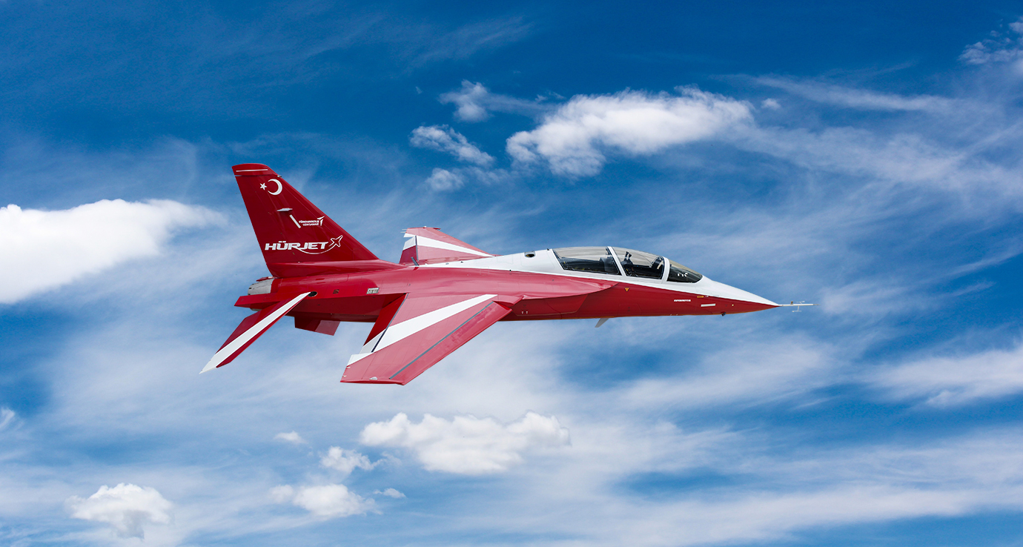
1. INTRODUCTION
1.1 Purpose of the thesis
1.2 Motivation of the thesis

Slide 5
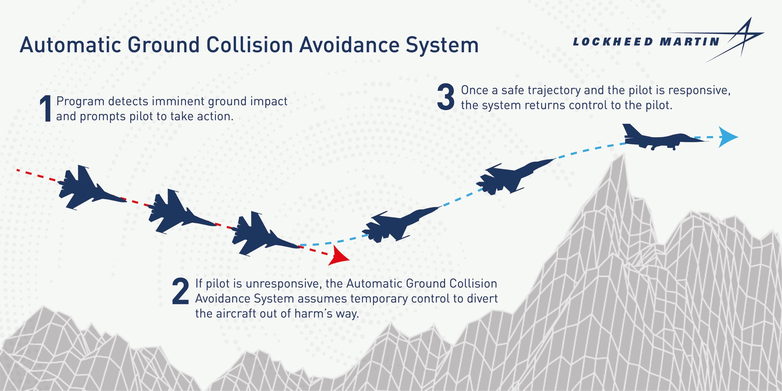
2. LITERATURE REVIEW
2.1 The timeline of Auto-GCAS

Slide 6
2. LITERATURE REVIEW
2.2 Auto-GCAS Background
Ensure Safety
Maintain Mission Effectiveness
Avoid Collisions
Forecasting
Communication
Resolution
Aggressiveness
Timeliness

Slide 7
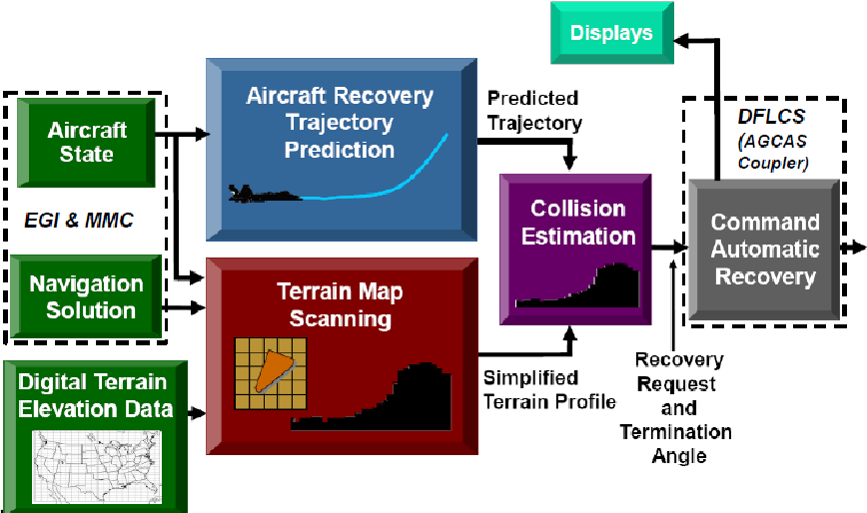
2. LITERATURE REVIEW
2.3 Auto-GCAS Overarching Design
Sensors
Terrain Databases
Trajectory Prediction Algorithm
Displays/Annunciators

Slide 8
3. Auto-GCAS METHODOLOGY
3.1 Auto-GCAS Methodology Overview
Ensure Safety
Maintain Mission Effectiveness
Avoid Collisions
Forecasting
Communication
Resolution
Aggressiveness
Timeliness

Slide 9
3. Auto-GCAS METHODOLOGY
3.2 Auto-GCAS Overarching Architecture
Sensors
Trajectory Prediction Algorithm
Displays/Annunciators

Slide 10
4. SIMULATION METHODOLOGY
4.1 Behind the Simulation
4.1.1 Aircraft and Inner Loop Controller Model Methodology
4.1.2 Auto-GCAS Methodology

Slide 11
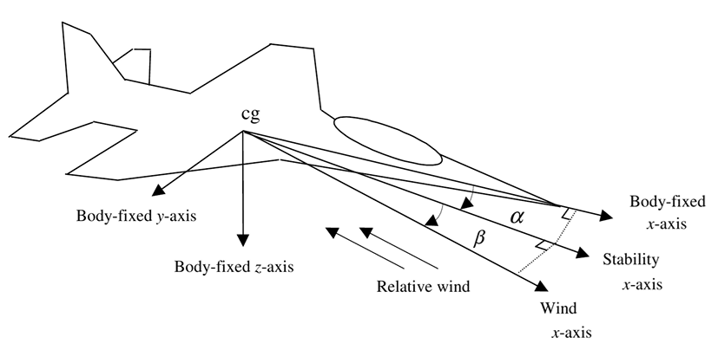
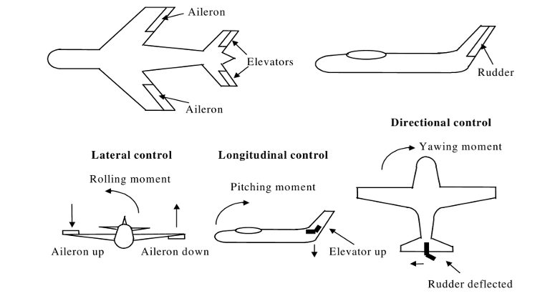
4. SIMULATION METHODOLOGY
4.1 Behind the Simulation
4.1.1 Aircraft and Inner Loop Controller Model Methodology

Slide 12
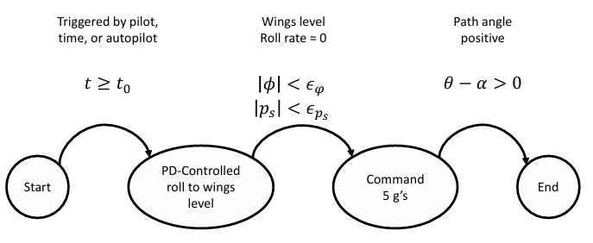
4. SIMULATION METHODOLOGY
4.1 Behind the Simulation
4.1.2 Auto-GCAS Methodology

Slide 13





4. SIMULATION METHODOLOGY
4.2 Simulation Setup

Slide 14
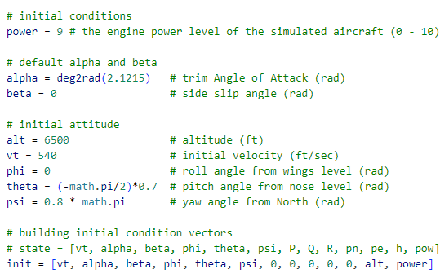
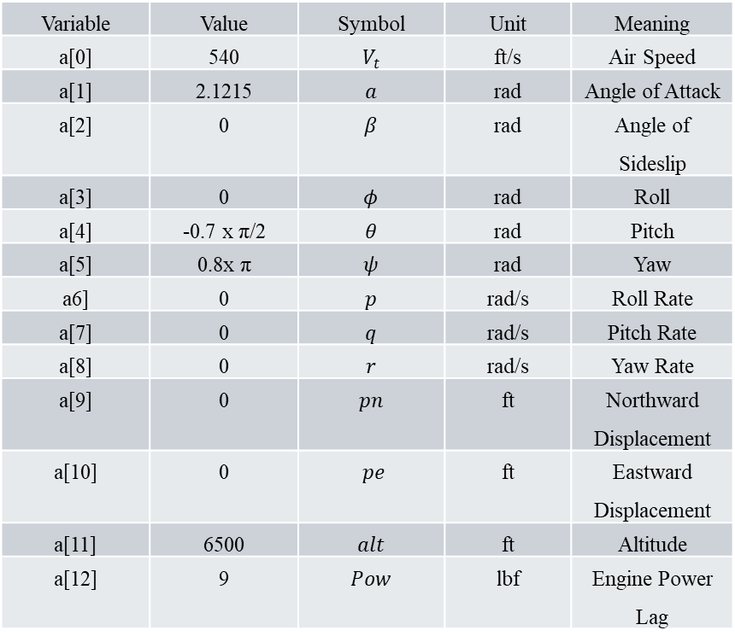
4. SIMULATION METHODOLOGY
Variable | Value | Symbol | Unit | Meaning
a[0] | 540 | $V_{t}$ | ft/s | Air Speed
a[1] | 2.1215 | $a$ | rad | Angle of Attack
a[2] | 0 | $β$ | rad | Angle of Sideslip
a[3] | 0 | $φ$ | rad | Roll
a[4] | -0.7 x π/2 | $θ$ | rad | Pitch
a[5] | 0.8x π | $ψ$ | rad | Yaw
a6] | 0 | $p$ | rad/s | Roll Rate
a[7] | 0 | $q$ | rad/s | Pitch Rate
a[8] | 0 | $r$ | rad/s | Yaw Rate
a[9] | 0 | $pn$ | ft | Northward Displacement
a[10] | 0 | $pe$ | ft | Eastward Displacement
a[11] | 6500 | $alt$ | ft | Altitude
a[12] | 9 | $Pow$ | lbf | Engine Power Lag
4.3 Simulation Process
Inital Conditions

Slide 15
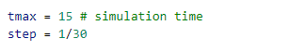
4. SIMULATION METHODOLOGY
4.3 Simulation Process
Simulation Duration
Variable | Value | Unit | Meaning
tmax | 15 | s | Simulation Time
step | 1/30 | s | Simulation Step Size

Slide 16
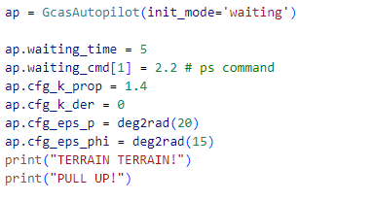
4. SIMULATION METHODOLOGY
Variable | Value | Unit | Meaning
init_mode | Waiting | str | Mode
waiting_time | 5 | s | Waiting Time
waiting_cmd | 2.2 | deg/s | Pitch Rate
cfg_k_prop | 1.4 | - | Proportional Gain
cfg_k_der | 0 | - | Derivative Gain
cfg_eps_p | deg2rad(20) | rad | Maximum Allowable Error Thresholds
cfg_eps_phi | deg2rad()15 | rad | Minimum Duration for Pull-Up Maneuver
- | TERRAIN TERRAIN! PULL UP! | str | Visual and Auditory Alerts
4.3 Simulation Process
Auto-GCAS

Slide 17
4. SIMULATION METHODOLOGY
4.3 Simulation Process
Model of the aircraft and the integration method

Slide 18
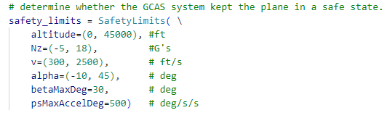
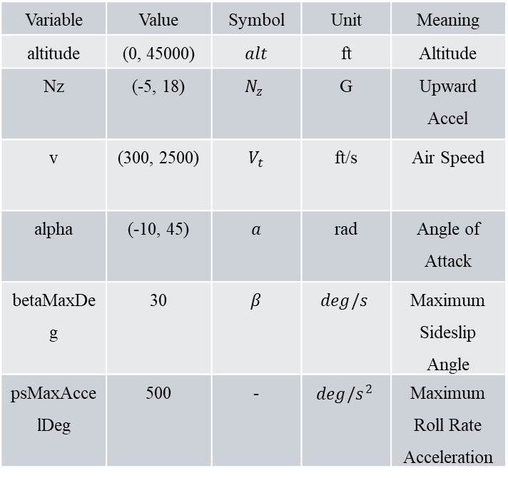
4. SIMULATION METHODOLOGY
4.3 Simulation Process
Inital Conditions
Variable | Value | Symbol | Unit | Meaning
altitude | (0, 45000) | $alt$ | ft | Altitude
Nz | (-5, 18) | $$N_{z}$$ | G | Upward Accel
v | (300, 2500) | $V_{t}$ | ft/s | Air Speed
alpha | (-10, 45) | $a$ | rad | Angle of Attack
betaMaxDeg | 30 | $β$ | $$deg/s$$ | Maximum Sideslip Angle
psMaxAccelDeg | 500 | - | $$deg/s^{2}$$ | Maximum Roll Rate Acceleration

Slide 19
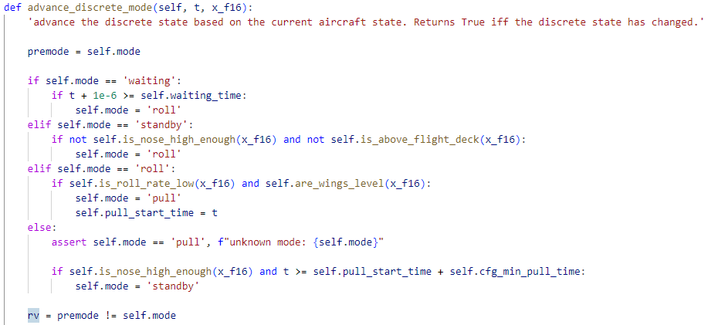
4. SIMULATION METHODOLOGY
4.4 Simulation Result

Slide 20
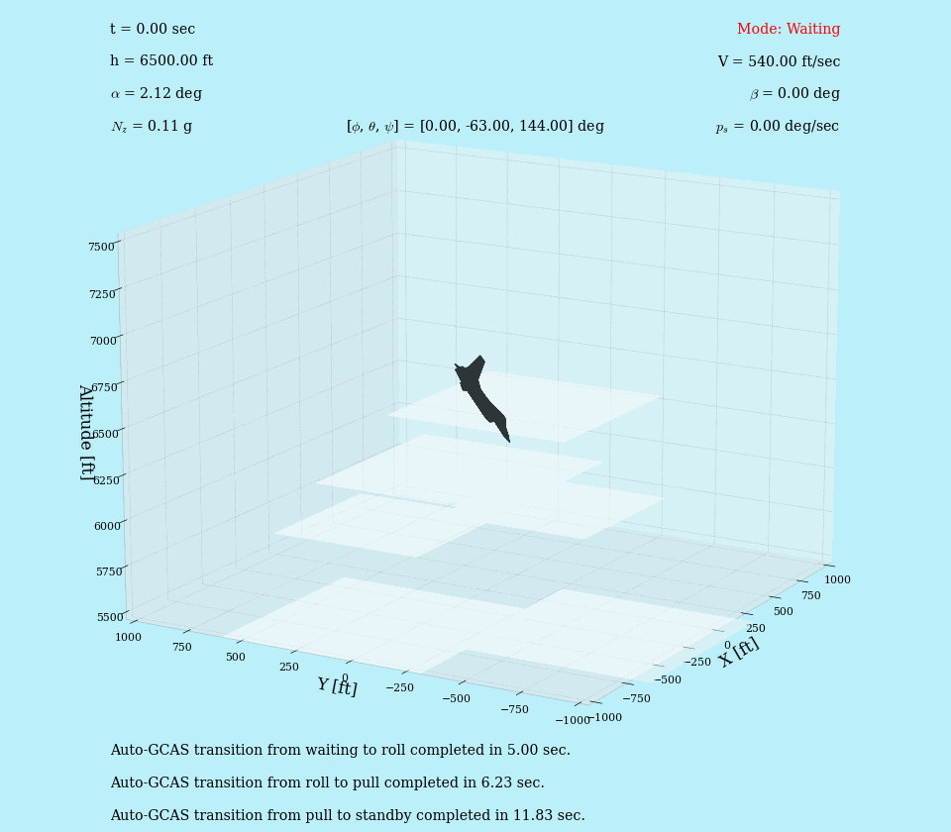

Slide 21
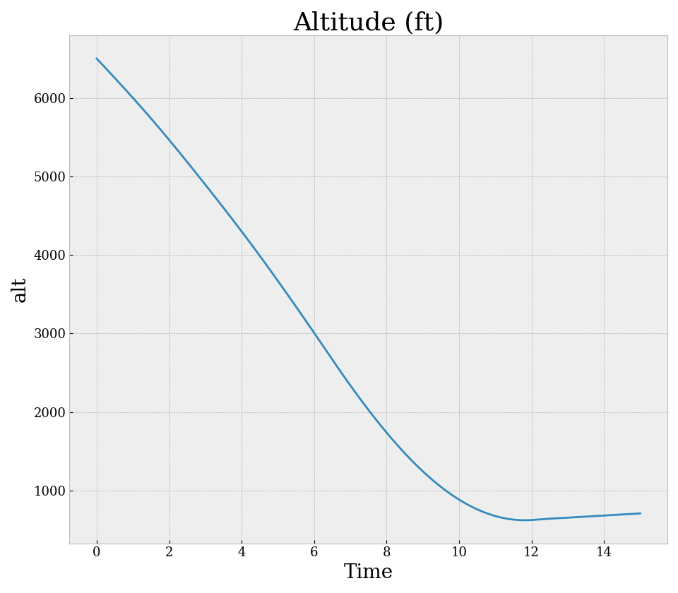
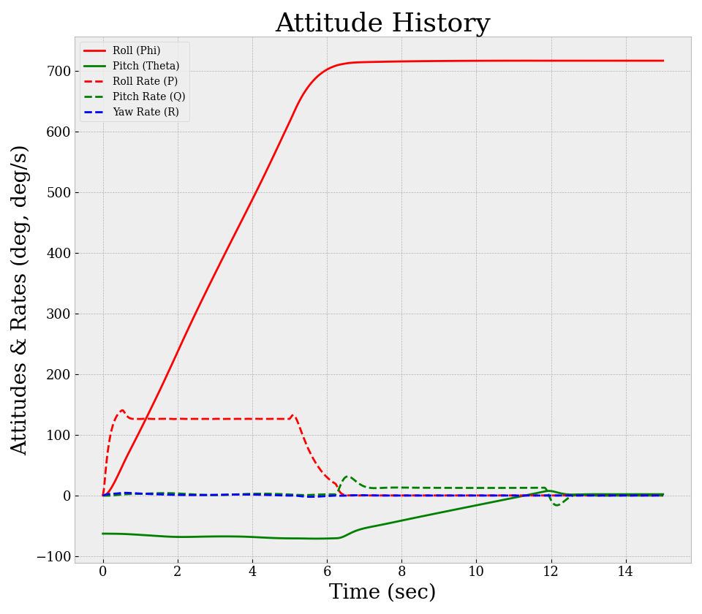

Slide 22
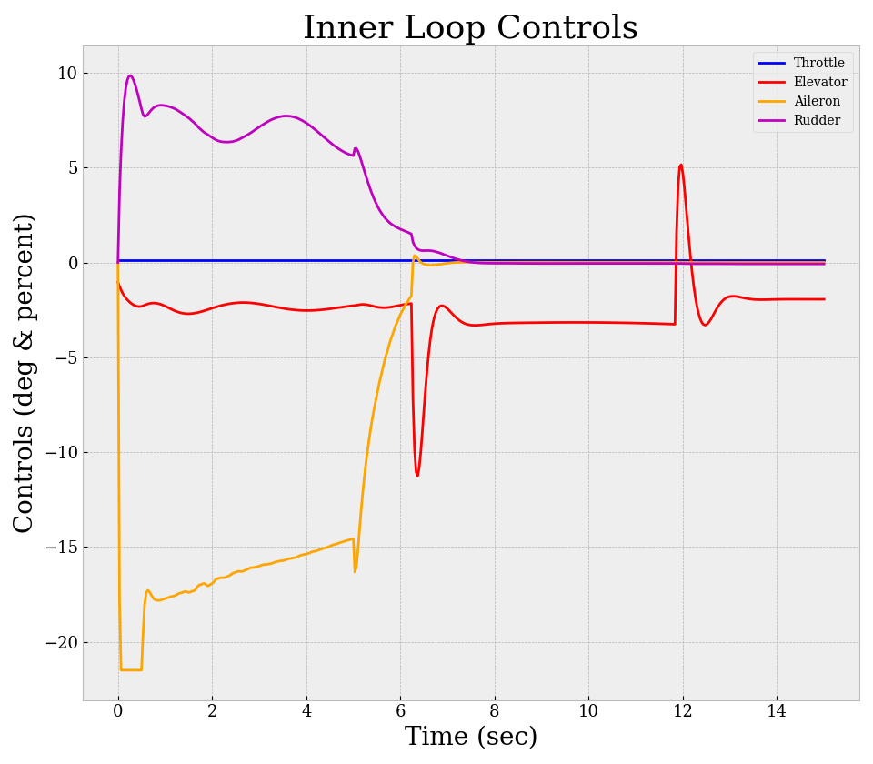
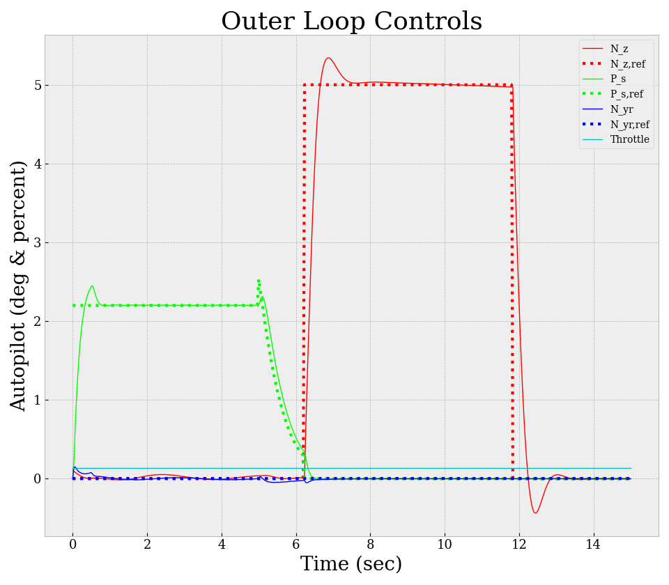

Slide 23
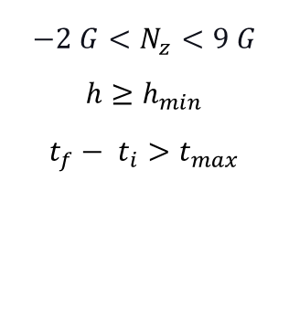
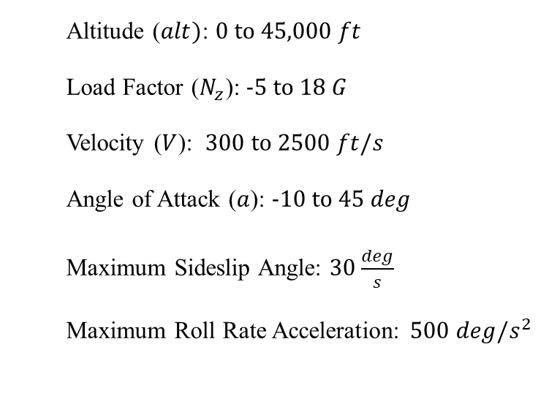
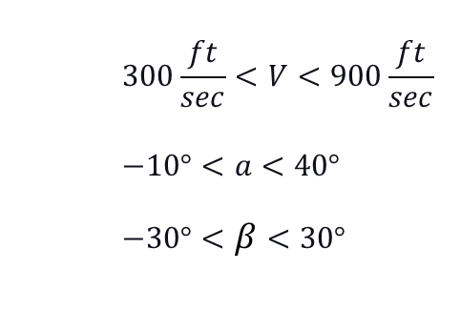
5. RESULTS AND DISCUSSION
5.1 Results
5.2 Discussion
5.3 Limitations and Future Work
Altitude ($alt)$: 0 to 45,000 $ft$
Load Factor ($N_{z}$): -5 to 18 $G$
Velocity ($V$): 300 to 2500 $ft/s$
Angle of Attack ($a$): -10 to 45 $deg$
Maximum Sideslip Angle: 30 $\frac{deg}{s}$
Maximum Roll Rate Acceleration: 500 $deg/s^{2}$
$$300\frac{ft}{sec}<V<900\frac{ft}{sec}$$
$$−10°<a<40°$$
$$−30°<β<30°$$
$$−2 G<N_{z}<9 G$$
$$h≥h_{min}$$
$$t_{f}− t_{i}>t_{max}$$

Slide 24
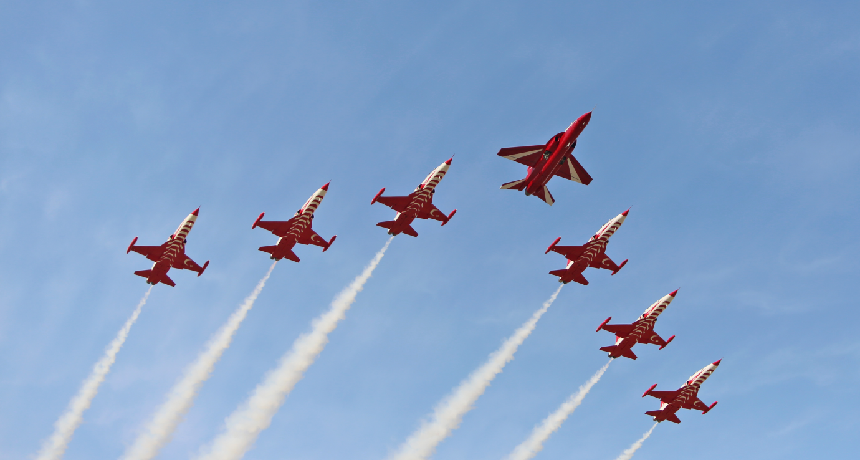
6. CONCLUSION

